Slide 1

Explore the world of Artificial Intelligence
Prompt Engineering
The Better You Explain, The Better The Response
Trainer : Syed Muhammad Taha

Slide 2
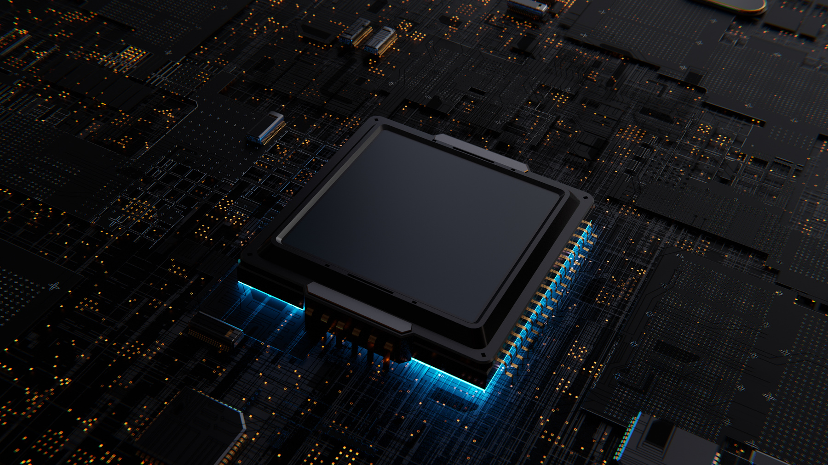
Course Outline (Beginner Level)
Understand what a prompt is
Learn how to communicate with AI properly
Practice basic formats & improve outputs
Practice Exercise

Slide 3
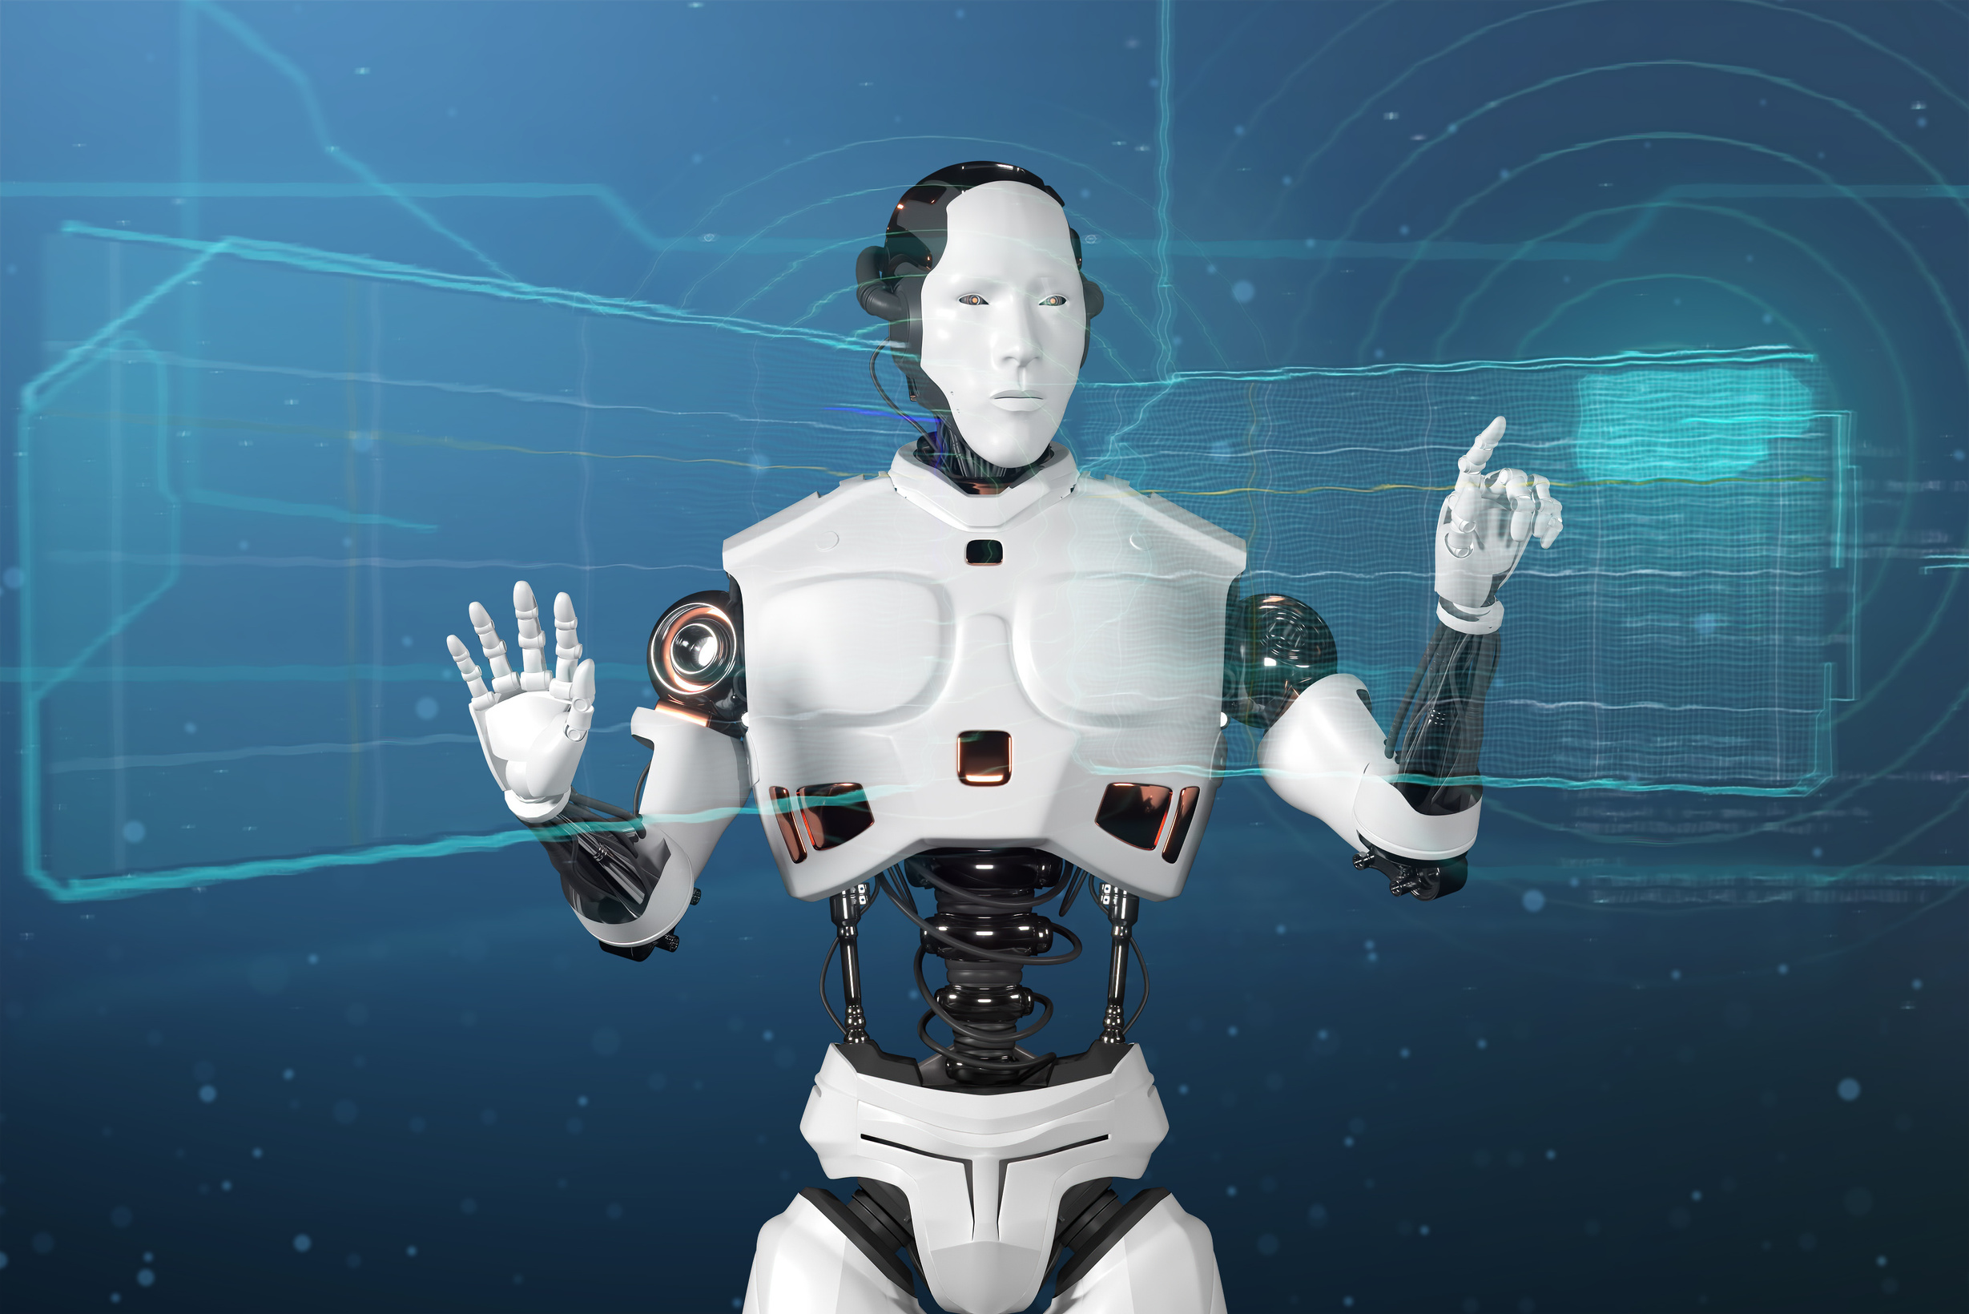
What is Prompt Engineering
Definition
A prompt is just the instruction or message you give to an AI to get the result you want.
Think of it like talking to a super assistant — the better you explain, the better the response.
Explanation
Example
You're giving a clear instruction (summarize), adding a condition (in simple words), and defining the target audience (a 10-year-old) — all of which help the AI give you exactly what you need.
Summarize this paragraph in simple words so a 10-year-old can understand it

Slide 4

Basic Prompt Structure
Instructions
A clear description of what you want the AI to do, like write, explain, summarize, etc
Input
The main content or subject the AI will use to generate a response, such as a paragraph, topic, or data.
Context
Any helpful background information that gives the AI a better understanding of the task or audience.
Input
The way you want the response presented — like a list, paragraph, table, or specific tone or style.

Slide 5
Types of Prompt Engineering
Zero-Shot Prompting
Chain-of-Thought Prompting
Definition
Definition
Asking the model to perform a task without giving any examples
Break complex tasks into steps. This gives better & more accurate responses. AI handles complex problems better when they are split into small logical steps
Example
Translate this sentence to French: I love programming.
Example
Explain function in python, then, give a simple example that adds two numbers.
One-Shot Prompting
Role-Base Prompting
Definition
Asking the model to perform a task without giving any examples
Definition
You can tell the AI what role to play, this gives it context & helps it answer better.
Example
Translate this sentence to French: I love programming.
Example
Act as a psychologist. Give advice to a student dealing with exam stress.

Slide 6
Types with real examples
Zero-Shot Prompting
Chain-of-Thought Prompting
Break this task into steps:
Start with a compelling subject line.
Briefly introduce yourself and your startup.
Describe the product and its unique features.
Explain the market opportunity.
End with a call to action.
Now write a professional email pitching an AI-powered CRM to investors using this structure.
Write a professional email to pitch a new AI-powered CRM product to potential investors.
One-Shot Prompting
Subject: Revolutionizing Health on the Go
Body: We’re excited to introduce HealthMate, a mobile app designed to track and improve daily wellness through AI insights.
Now write a professional email to pitch a new AI-powered CRM product to investors
Role-Base Prompting
Act as a startup founder preparing for a pitch. Write a professional email to introduce your AI-powered CRM to potential investors, highlighting innovation and market potential.

Slide 7


Tips for a Better Prompt
Be Clear & Specific
The more clearly you define what you want, the better the AI can understand and respond to your request. Avoid vague instructions.
Mention the Format
Telling the AI how you want the output helps shape the response exactly the way you need it, making it easier to use or present.
Use Plain Language
Keep the prompt simple and straightforward so the AI doesn’t misinterpret it.
Ask in Steps if Needed
If your task is complex, break it into smaller parts. This helps the AI focus on one thing at a time and gives you better results.

Slide 8
Let’s Practice
Task 1
Task 4
In your own words, explain what a prompt is and why it's important when working with AI?
Choose any one of your prompts, enter it into ChatGPT (or any AI tool), and write
The prompt you used
The response you received
What you liked/disliked about the response
How you would improve your prompt to get a better answer
Task 2
List of 5 healthy habits
A short joke about school
A motivational quote for Aptech students
Task 5
Task 3
Now, all the topics we have learned in Class, you all should prepare assignments on these topics yourselves for practice.
Write three different prompts to ask the AI the same question: What are the benefits of learning Prompt Engineering?

Slide 9



Generative AI Examples

Slide 10



Generative AI Examples

Slide 11
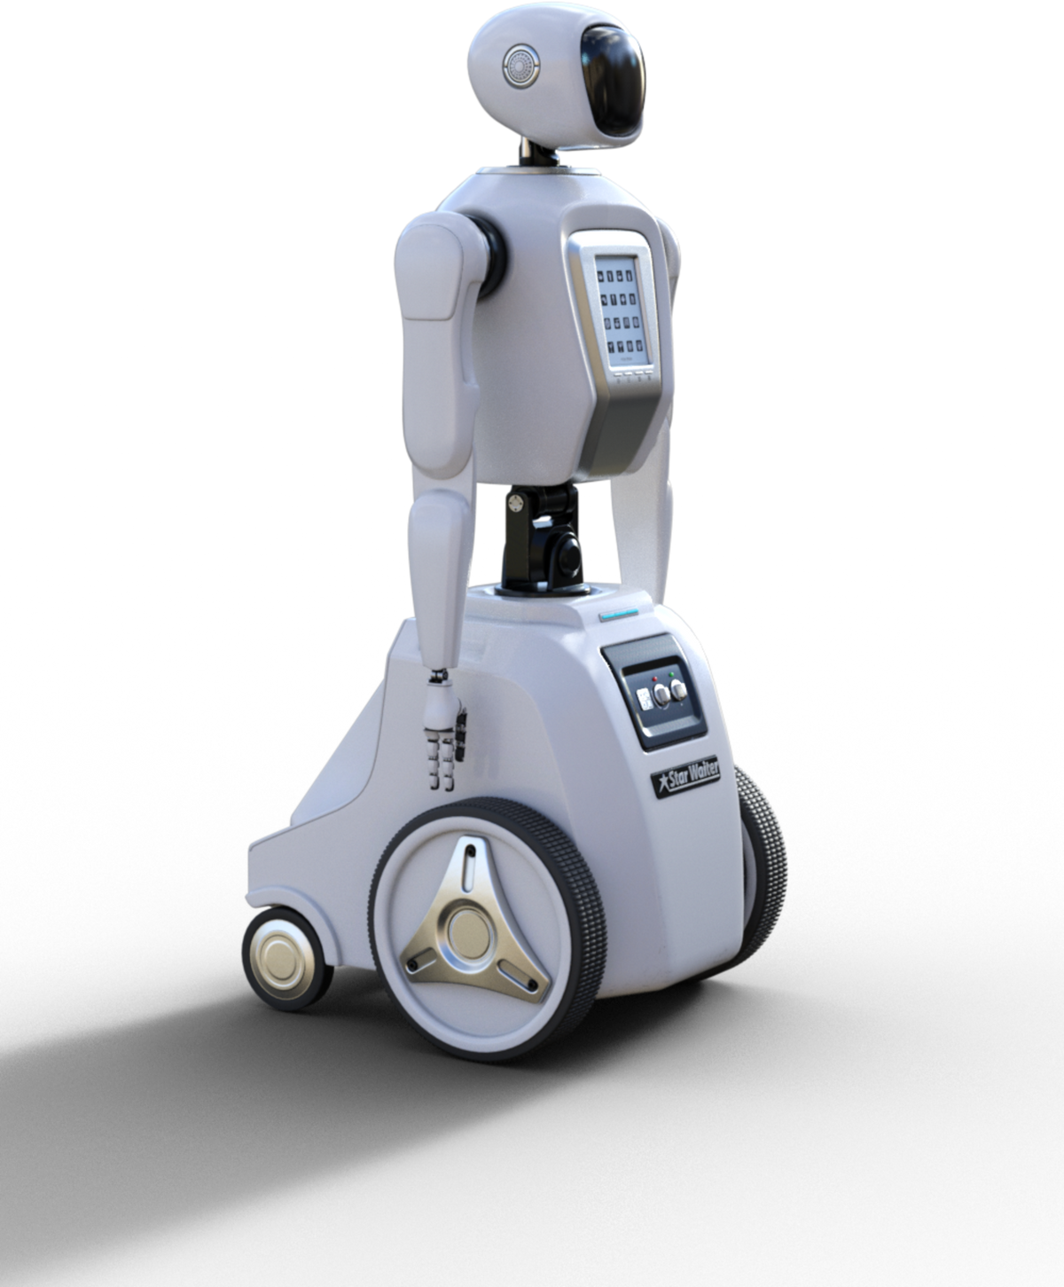
Thank You
FOR YOUR ATTENTION

